Slide 1
Sales Data Analysis
Group 22

Slide 2
Table of contents
01
04
02
05
03
06
Introduction
Designing System
Problem Description
Achievements
Dataset
Conclusion

Slide 3

01
Introduction

Slide 4
Introduction
Data analysts strive to comprehend an organization's data and ensure its accessibility for informed business decision-making.
Assume that all the data are purchased from a single shopping mall, and our manager is asking for specific reports and presentations.
For instance, this includes monthly income, annual income, sales figures within specific age brackets, and sales amounts categorized by different product categories...

Slide 5
02
Problem Description

Slide 6

Problem Description

Slide 7
03
Dataset

Slide 8
Dataset
Our dataset contains shopping information from 10 different shopping malls between 2021 and 2023.
We have gathered data from various age groups and genders to provide a comprehensive view of shopping habits in Istanbul.
The dataset includes essential information such as invoice numbers, customer IDs, age, gender, payment methods, product categories, quantity, price, order dates, and shopping mall locations.

Slide 9
Dataset
Content Attribute Information
invoice_no: Invoice number. Nominal. A combination of the letter 'I' and a 6-digit integer uniquely assigned to each operation.
customer_id: Customer number. Nominal. A combination of the letter 'C' and a 6-digit integer uniquely assigned to each operation.
gender: String variable of the customer's gender.
age: Positive Integer variable of the customers age.
category: String variable of the category of the purchased product.
quantity: The quantities of each product (item) per transaction. Numeric.
price: Unit price. Numeric. Product price per unit in Turkish Liras (TL).
payment_method: String variable of the payment method (cash, credit card or debit card) used for the transaction.
invoice_date: Invoice date. The day when a transaction was generated.
shopping_mall: String variable of the name of the shopping mall where the transaction was made.

Slide 10
04
Designing System

Slide 11
Data Preprocessing
Checking for missing and duplicated data
Before conducting data analysis, it is essential to check for missing and duplicated data and handle them.
There is no value returned for duplicated values and missing values.

Slide 12
Data Preprocessing
Checking for missing and duplicated data
Before conducting data analysis, it is essential to check for missing and duplicated data and handle them.
There is no value returned for duplicated values and missing values.
 | feature | dtype | total_count | unique_count | missing_count | missing_percentage
0 | invoice_no | object | 99457 | 99457 | 0 | 0.00
1 | customer_id | object | 99457 | 99457 | 0 | 0.00
2 | gender | object | 99457 | 2 | 0 | 0.00
3 | age | int64 | 99457 | 52 | 0 | 0.00
4 | category | object | 99457 | 8 | 0 | 0.00
5 | quantity | int64 | 99457 | 5 | 0 | 0.00
6 | price | float64 | 99457 | 40 | 0 | 0.00
7 | payment_method | object | 99457 | 3 | 0 | 0.00
8 | invoice_date | object | 99457 | 797 | 0 | 0.00
9 | shopping_mall | object | 99457 | 10 | 0 | 0.00

Slide 13
Data Preprocessing
Change data type
The data type of "invoice_date" is incorrect. We’re going to change the data type of this variable to datetime format.
No missing data is present.
There are no unusual expressions such as ? - */ . null, minus price,age,quantity etc.
Each customer is unique, it means that each customer have visited the shopping mall only once.
ach invoice is unique, reflecting the purchase of only one product per invoice.
"invoice_no" and "customer_id" serve as indexes and represent each row, but we already have index in this case so we can drop it.

Slide 14
Exploratory Data Analysis
Gender Distribution
What is the distribution of shopping based on gender?
Which gender has the higher number of product sales?
Which gender contributed more to the overall revenue?
Distribution of purchase categories relative to other columns?

Slide 15
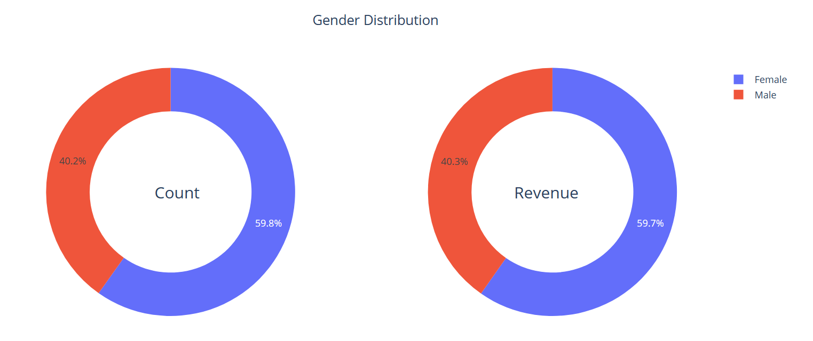
Exploratory Data Analysis
Gender Distribution
We have generated more revenue from women.
We have sold more products to women.

Slide 16
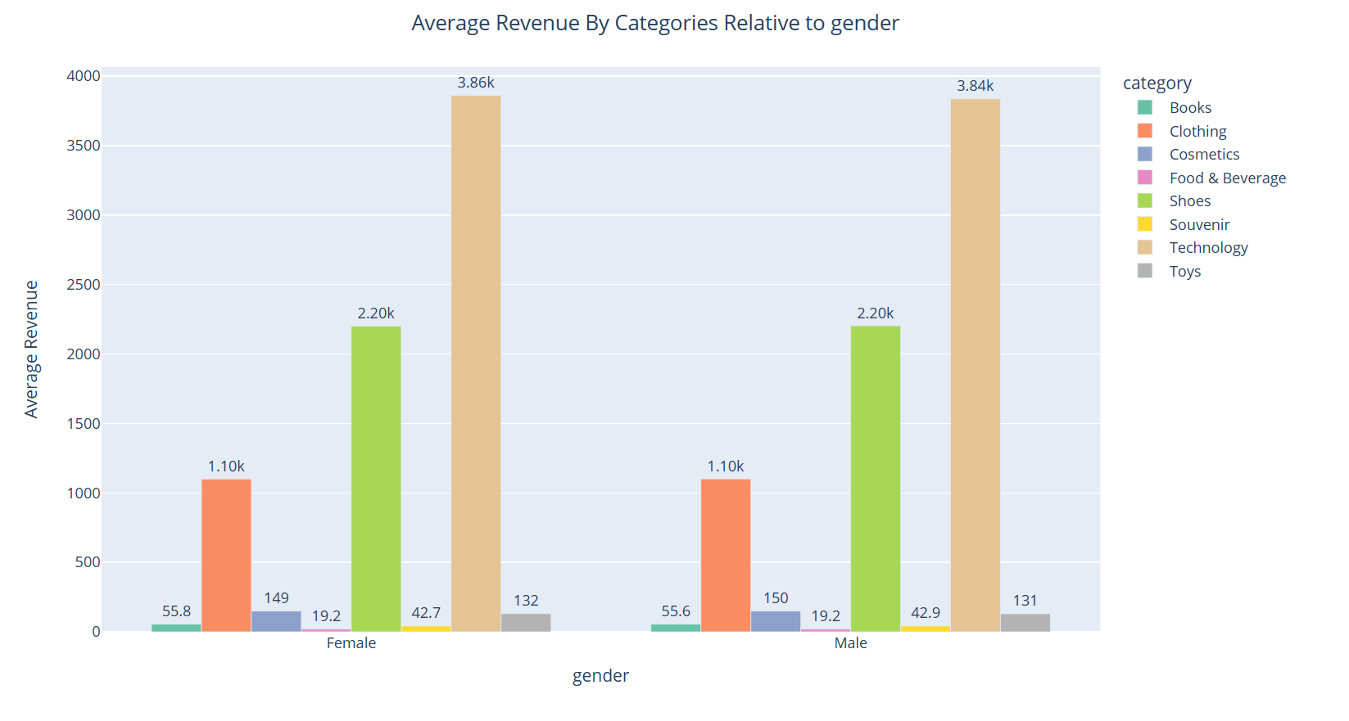
Exploratory Data Analysis
Gender Distribution
On average, revenue per product indicates that men generate slightly more revenue than women.

Slide 17
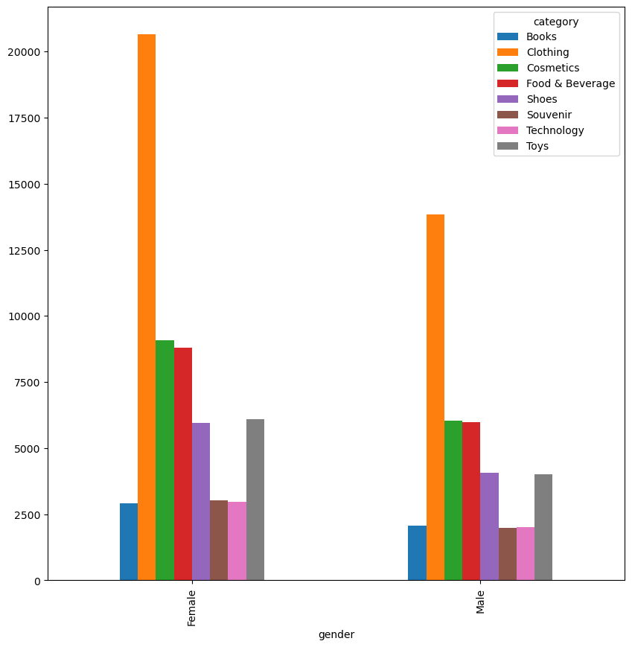
Exploratory Data Analysis
Gender Distribution
The ratio of products sold to women, when analyzed by category and gender, seems consistent with the ratio of products sold to men.
In all categories, women have bought 1.5 times more products than men.

Slide 18
Exploratory Data Analysis
Age Distribution
What is the distribution of shopping based on age?
Which age category has the highest number of product sales?
Which age category contributed more to the overall revenue?
How do the purchase categories distribute concerning other columns?

Slide 19
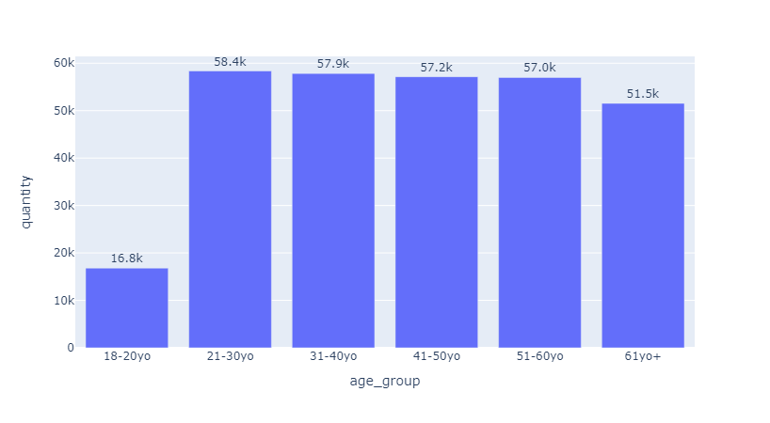
Exploratory Data Analysis
Age Distribution
Based on the data, the middle age group experienced the highest quantity of products sold, whereas young people had the lowest quantity of products sold.

Slide 20
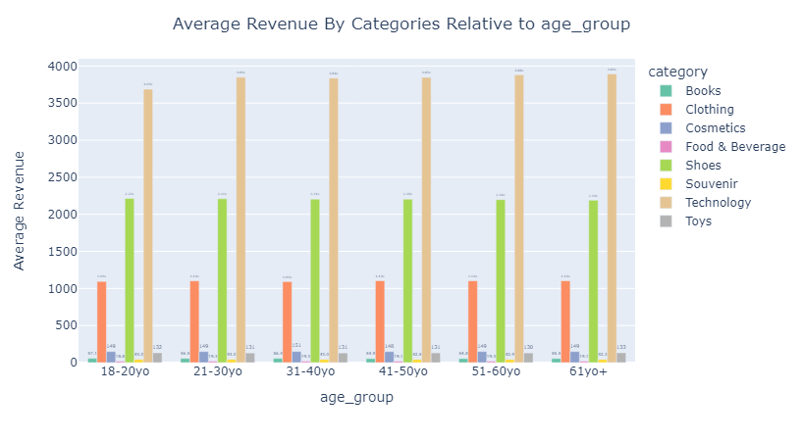
Exploratory Data Analysis
Age Distribution
Average spending is the same and has not changed according to any age category.

Slide 21
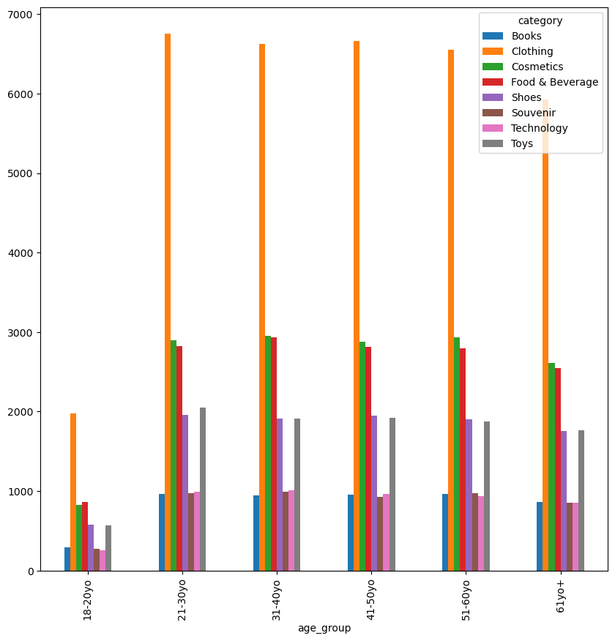
Exploratory Data Analysis
Age Distribution
Middle-aged individuals have purchased an equivalent quantity of products as elderly individuals.
In all categories, middle-aged individuals purchased 1.5 times more products than young people.

Slide 22
Exploratory Data Analysis
Payment Method Distribution
Does the payment method have a relation with other columns?
How is the distribution of the payment method?

Slide 23
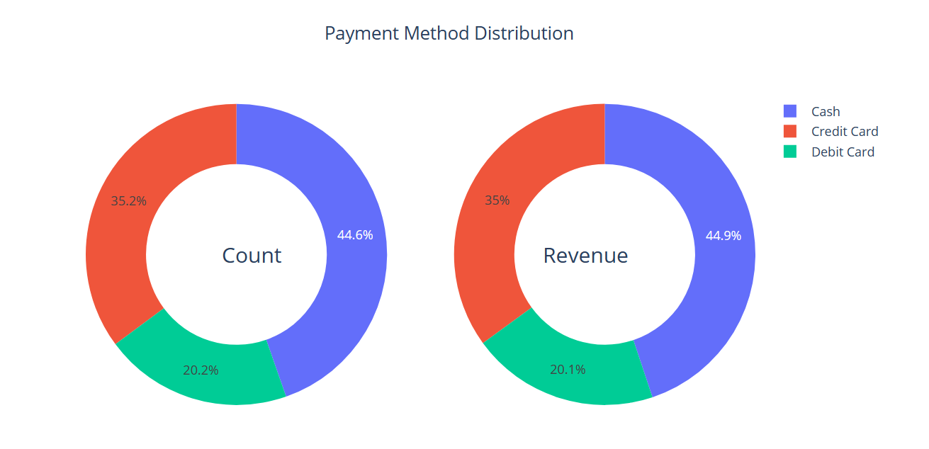
Exploratory Data Analysis
Payment Method Distribution
In terms of payment distribution, cash payments contribute the highest revenue and sales volume, followed by credit card payments, and finally, debit card payments.

Slide 24
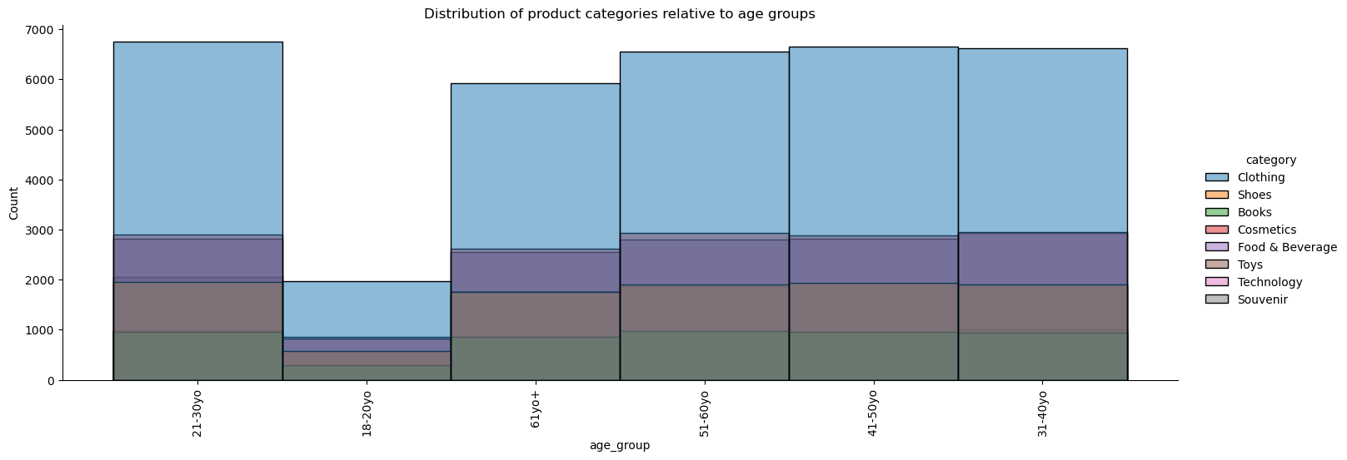
Exploratory Data Analysis
Payment Method Distribution
There appears to be no correlation between the age_group variable and the chosen payment method.

Slide 25
Exploratory Data Analysis
Payment Method Distribution
Across all product categories, the volume of cash payments is 2.2 times greater than payments made with a bank card.
 | Category | Cash/Card ratio
0 | Books | 2.21
1 | Clothing | 2.20
2 | Cosmetics | 2.15
3 | Food & Beverage | 2.21
4 | Shoes | 2.25
5 | Souvenir | 2.11
6 | Technology | 2.25
7 | Toys | 2.33

Slide 26
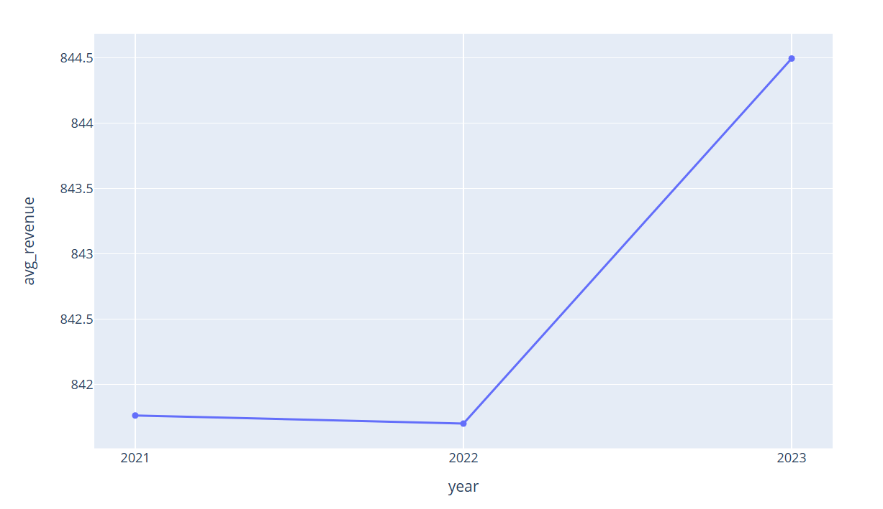
Exploratory Data Analysis
Date Distribution
The annual discrepancy remains constant, with a daily difference of 100 TL, a monthly difference of 60 TL, and a weekly difference of 40 TL.

Slide 27
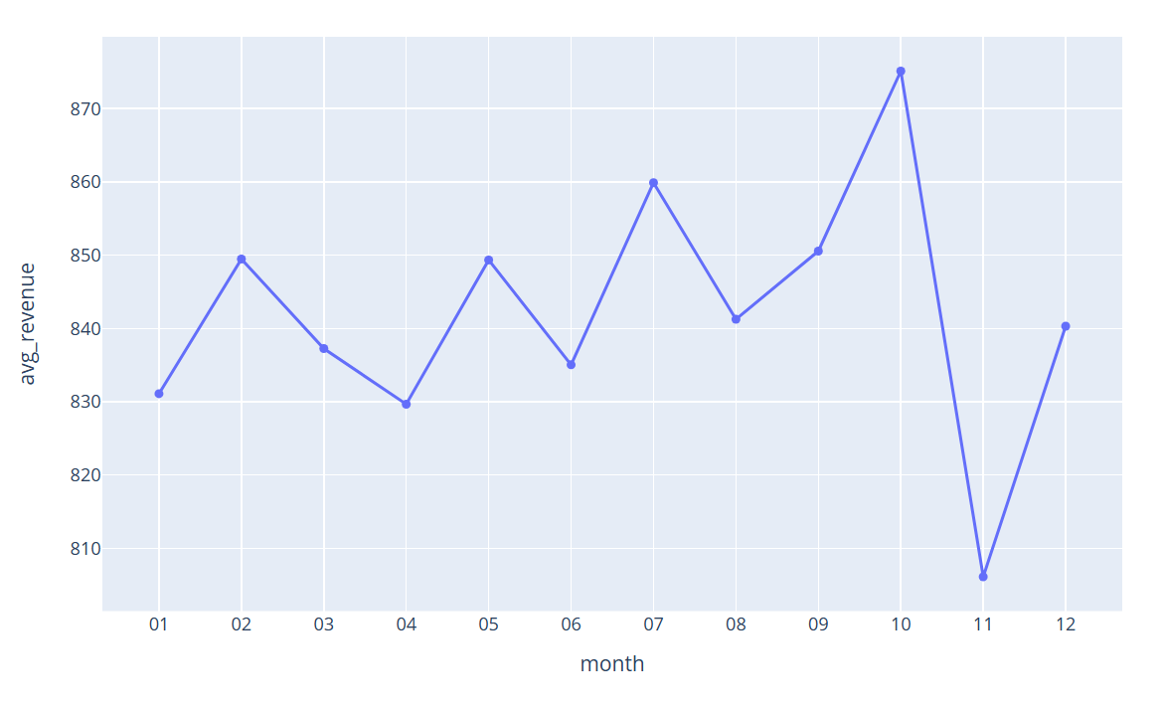
Exploratory Data Analysis
Date Distribution
The annual discrepancy remains constant, with a daily difference of 100 TL, a monthly difference of 60 TL, and a weekly difference of 40 TL.

Slide 28
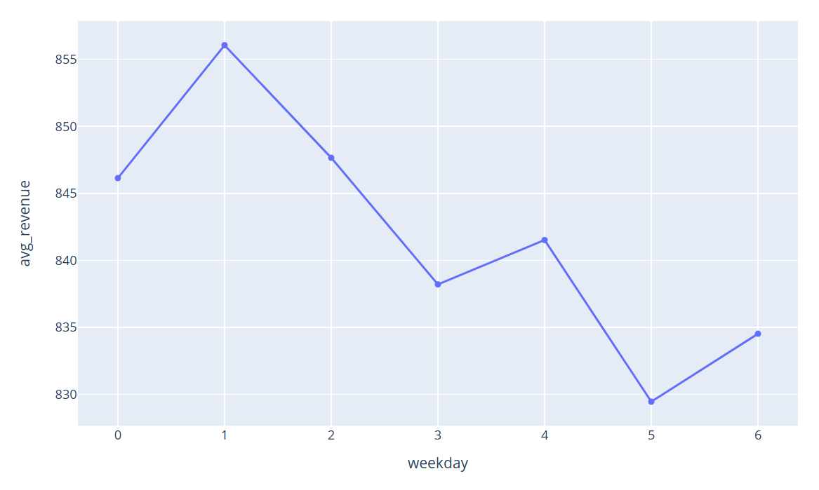
Exploratory Data Analysis
Date Distribution
The annual discrepancy remains constant, with a daily difference of 100 TL, a monthly difference of 60 TL, and a weekly difference of 40 TL.

Slide 29
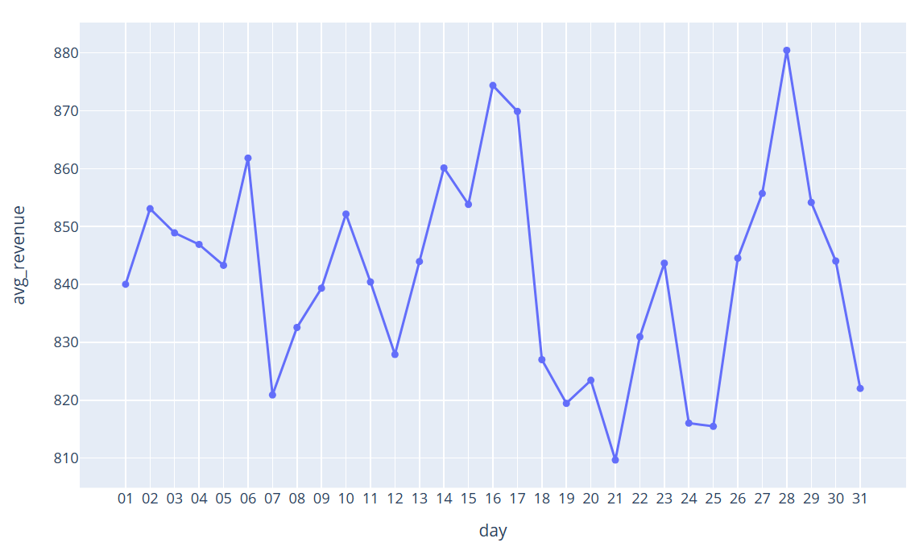
Exploratory Data Analysis
Date Distribution
The annual discrepancy remains constant, with a daily difference of 100 TL, a monthly difference of 60 TL, and a weekly difference of 40 TL.

Slide 30
05
Achievements

Slide 31
Insights
Key demographics:
Gender Distribution: We generate more revenue from women, and they also purchase more products than men. However, the average revenue per product is slightly higher for men.
Age Distribution: The highest quantity of products sold is within the middle age group, while young people contribute the least to the overall sales volume. Moreover, middle-aged individuals consistently purchase 1.5 times more products across all categories compared to young people.
Purchasing Patterns:
Monthly Revenue Peaks: The periods generating the most average revenue are mid-month (around days 15 and 16) and end of the month (around day 28).
Category Revenue: The highest revenue is observed in the categories of technology, clothing, and shoes.

Slide 32
Insights
Product Sales Ratios:
Gender-Based Product Sales: Although the ratio of products sold to women compared to men seems consistent across categories, women have purchased 1.5 times more products than men in all categories.
Age-Based Product Sales: Middle-aged individuals consistently buy 1.5 times more products in all categories compared to young people.
Payment Methods:
Payment Method Distribution: Cash payments contribute the highest revenue and sales volume, followed by credit card payments and debit card payments.
Age Group and Payment Method: No significant relationship is observed between the age group variable and the chosen payment method.

Slide 33
Insights
Customer Value Segmentation:
Most Valuable Customers: Middle-aged women emerge as the most valuable customers, consistently contributing higher revenue.
Least Valuable Customers: Conversely, young men appear to be the least valuable customers, contributing less to overall sales.

Slide 34
Strategic Recommendations
Targeted Campaigns for Middle-Aged Women
Young Men Engagement Campaigns
Loyalty Program Enhancements
Payment Method Promotion
Communication of Consistent Pricing
Referral Program for Women

Slide 35
06
Conclusion

Slide 36
Conclusion
There are much more that can be done such as customer segmentation to define segments customer and adjust our strategies accordingly.
We originally planned to conduct RFM (Recency, Frequency, Monetary) Analysis.
RFM helps create segments of ’important customers’. Those customers are the ones most likely to have the highest return on marketing investments.
Specifically, the analysis can help improve targeting, reduce costs, and increase return on advertising investments.
However, this could not be done due to our data having only 1 customer per invoice, making the frequency of each customer being 1. This makes our RFM misleading since we cannot correctly define customers that are ’important’.

Slide 37
Thank you for listening!
Team members
Nguyễn Trung Trực 20214936
Lê Trung Kiên 20214907
Nguyễn Thế An 20210006
Đỗ Đình Kiên 20214906
Reference
Dataset: https://www.kaggle.com/datasets/mehmettahiraslan/customer-shopping-dataset

